Slide 1

Phase 2
Final Review

Slide 2
FIT-FINITY
Health and Fitness based platform
Project Supervisor : Dr. Pankaj Kumar

Slide 3
Group Members
20MIP10028
20BCE10374
20BCE11076
20MIP10035
20BCE11082
20BAI10194
20MIP10020
20BCY10005
Akshatt Chhabra
Anannya Manojawas
Madhav Mishra
Ishika Shrivastava
Harshit Dwivedi
Shrey Khanduja
Ujjwal Srivastava
Avinash Roy

Slide 4
Content
Introduction
Motivation
Differences
Purpose
Individual Contribution
Objective
Existing project
Module Split Up
Outcome
References

Slide 5
Introduction
Fit-Finity can be a valuable tool for individuals looking to improve their fitness and achieve their health goals.
Our webapp recommends specific exercises catering to the demands and objectives of each particular individual, thus making our applications more efficient and successful
With daily progress and results from their exercise routine, this web app will encourage them to continue working towards their goals

Slide 6
Objective
01
To give a generalised Diet recommendation based on the user’s age and medical complications so as to make their eating practises better thus meeting their nutritional requirements.
Diet and nutrition
02
Using numerous articles, and other helpful materials, to assure awareness about users' health and ways to enhance it.
Providing health and wellness information

Slide 7
Objective
Fit- Fitfinity aim to help people tracking day-today condition, staying on track with their goals which could help them to spread awareness about their own health .
03
Awareness
04
Fit - Fitnity is primarily designed for the devices that are portable and widely available, allowing users to access health-related information and tools anytime and anywhere.
Portability

Slide 8
Motivation
Major driver of motivation is the desire to help others. We're motivated by our sense of purpose and our desire to make a difference in people's lives. We are convinced that using our app may considerably enhance people's health and wellness.
No of their age, people are struggling with a number of medical difficulties since people nowadays are unable to take care of their physical well-being.
People now expect everything to be at their home as a result of the recent shift to digital technology.
This inspired us to create a platform so that we could assist people in strengthening their immunity.
People have come to understand the value of having a solid and strong immune system as a result of the current covid outbreak.

Slide 9





Existing Work
During our research we found several platforms/applications that were based on
Health and Fitness. Some of the platforms are as follows:
Workout Trainer
.
JEFIT
J&J
Strava
Strava activity tracking provides key statistics, such as speed, pace,
distance, elevation gained, and calories burned during and after exercise.
JEFIT enables you to track your workout routines and your rest time, and log and graph all body measurements as you progress
Centered around research on high-intensity interval training (HIIT) and circuit training, which shows that short bursts of hard exercise
Works as a personal trainer and provides guidance to do
specific exercises, training sessions and recording.

Slide 10
Differences
Existing Projects
Fit-Finity
1. Concentrated on exercises required for either muscle building or weight loss.
1. Problem Specific Exercise/Yoga recommendations
2. Don't specify the dietary guidelines we should adhere to in order to live healthy lives.
3. Doesn't provide details on the meals we should eat to avoid medical concerns.
2. By regularly imparting nutritional knowledge, Fit-Finity helps people change their eating habits by providing a generalised Balance Diet.
3. Provides Health analysis report (BMI etc).

Slide 11
Module Split-Up
DAY 1
DAY 2
DAY 3
DAY 4
DAY 5
Backend
Development
Fit-Finity
Frontend
Development
Database

Slide 12
Database
Database
Collection
Database
Cleaning
Data
Analysis
Database
Formation
Here, we used a Google Form to survey people about their stress levels, active lifestyles, and medical issues. We collected all gathered Information in Database1
We discovered that the data in the Database1 was not available in the proper format, with some entries being duplicated, several entries including complication that was misspelt, numerous necessary entries being blank, and the Complication section including every issue in one cell. So a sound Preprocessing was required.
After completing the preprocessing of Database 1, we performed data analysis on a Python Jupyter Notebook, which is crucial in transforming the gathered information into a more accurate and pertinent form and facilitating our ability to:
1) make decisions,
2) solve problems,
3) understand,
4) improve processes, and 5) comprehend users.
Once the Data Analysis gets over, we created a new database called Health_Output that contains a variety of medical complications (back_pain, eyes_pain, cardiovascular, etc.) that are accessed through our analysis, preferred yoga poses (such as camel pose, child pose, frog pose, etc.) to treat these issues, and personalised diets.

Slide 13
Backend
APP - In the backend part of the project App.py was the main file which performs all the backend operations in the project.
Operations in App.py:
Providing interface for the FLASK operations
Rendering all the HTML pages from the template folder.
Making the form1 and 2 responsive by fetching the values from the user and displaying them as output after processing it.
Implementing the SQL query for matching the user inputs.
Giving output to the frontend in order to display them.

Slide 14
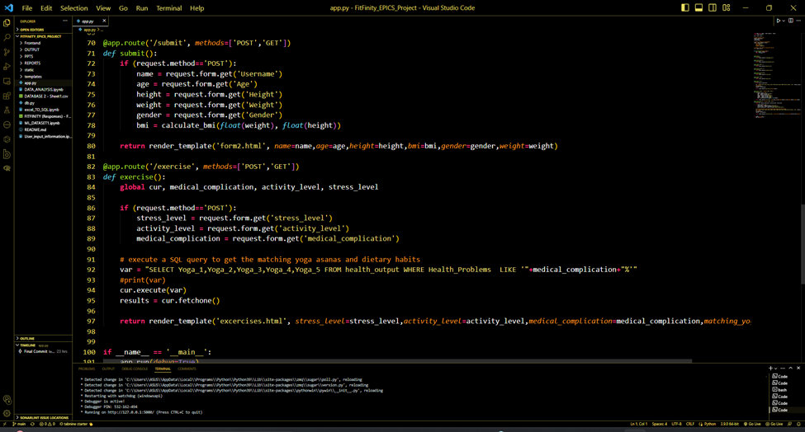

Slide 15
Frontend
Landing Page
Get Started
Analysis
File name:
Landingpage.html
1. This is the landing page of our project which contains a navigation bar through which the user can go to multiple pages of the platform.
File name:
1. Form1.html
2. Form2.html
3. Exercise.html
4. Diet.html
In the Form1 the basic details of the user is asked in the form which then goes to form2 which displays the BMI etc and asks for further details and at last exercise and diet files show the output.
File name: Data_Analysis.html
This file displays the analysis which has been performed on the dataset collected from the survey.

Slide 16
Frontend
About Us
Contact Us
Yogas
File name:
Aboutus.html
In this page we have mentioned about ourselves and our project and it’s objectives. Team member details are also given there.
File name:
Contactus.html
In this page our contact details are mentioned if someone urges to reach us.
File Name:
Yogas.html
This Segment contains a description of all the exercises recommended in the Exercises section under Get Started to Begin with. It contains images best suited for recommended yoga poses and step-by-step procedures for performing yoga poses.

Slide 17
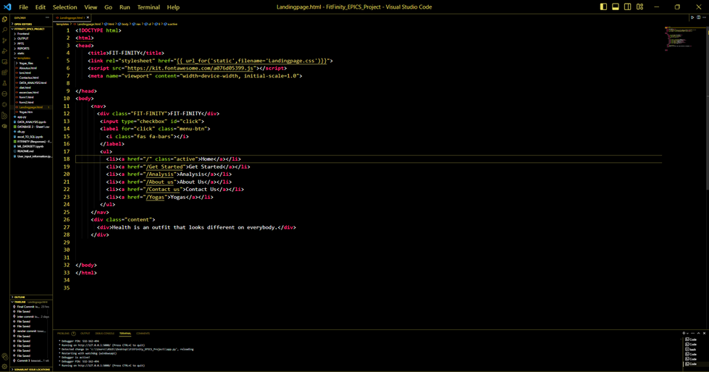
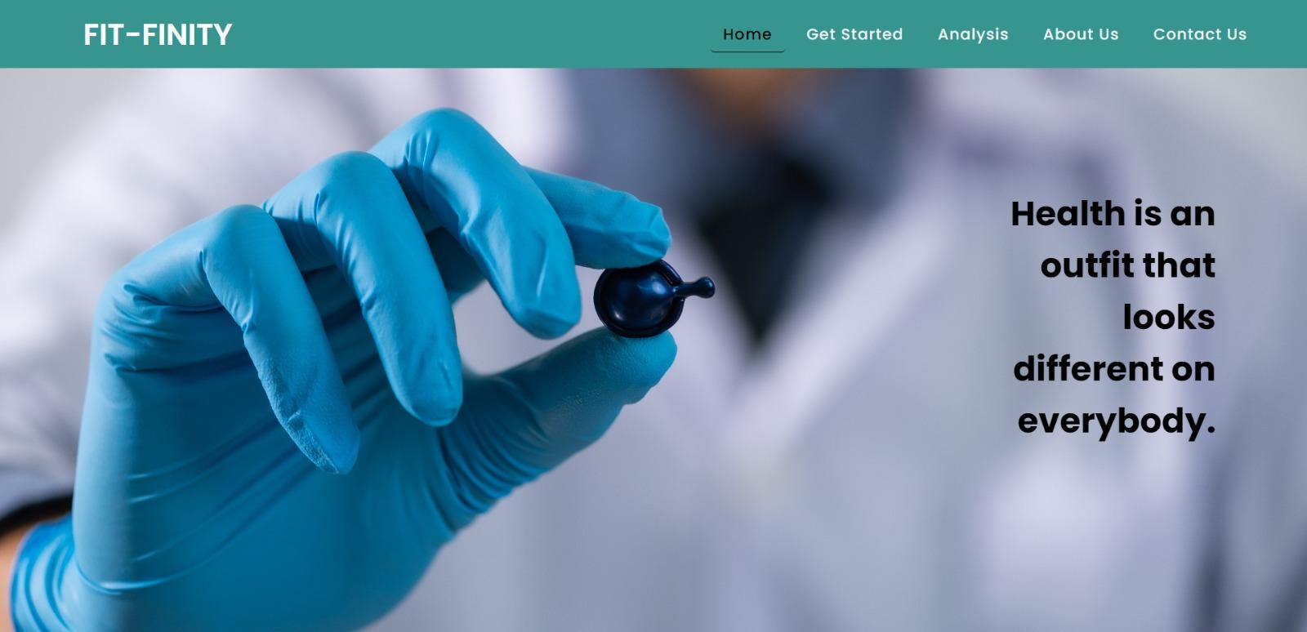

Slide 18
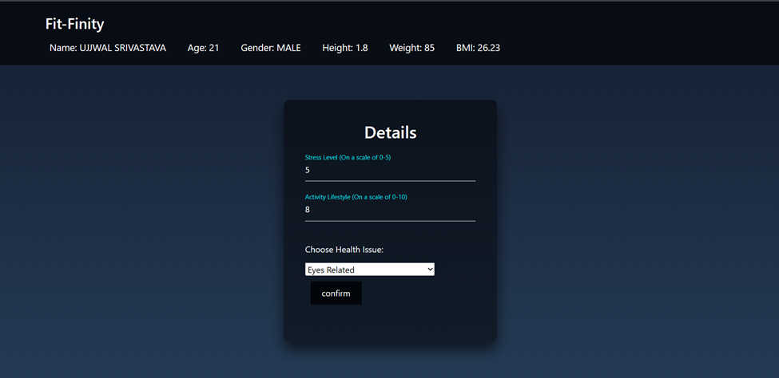
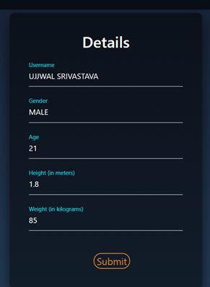
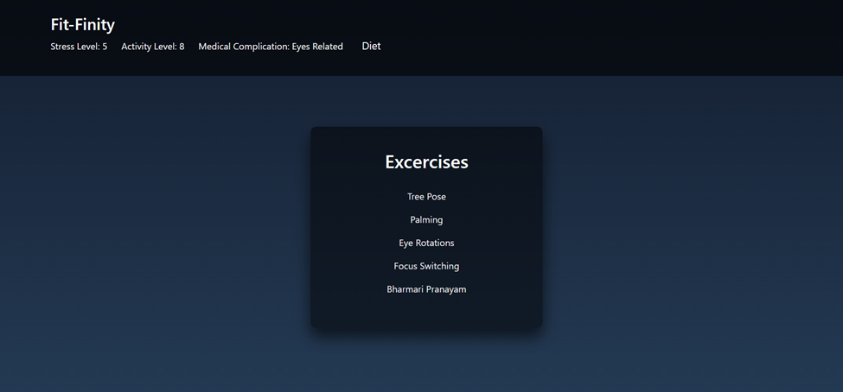

Slide 19
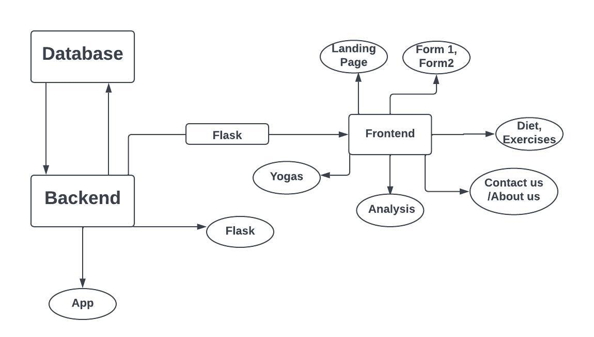
System Architecture

Slide 20
Outcome
Personalized Exercise Recommendations
Tailored exercises based on individual demands and objectives.
Customized routines for fitness level, preferences, and goals.
Improved Eating Practices
Balanced diet plan for healthier eating habits.
Regular access to nutritional facts and information.
Enhanced Health and Wellness Awareness
Extensive resources (articles, videos, etc.) for health and wellness education.
Deeper understanding and effective strategies for improved well-being.

Slide 21
Outcome
Continuous Motivation
Daily progress tracking and results from exercise routines.
Tangible results and improvements to motivate continued fitness journey.
Successful Goal Achievement
Valuable tool for achieving fitness and health objectives.
Combining personalized exercise recommendations, improved eating practices, and continuous motivation.

Slide 22
Impact on the Public Community
Fitness accessibility for everyone, regardless of background or location.
Web app available to anyone with an internet connection.
01
Accessible Fitness for All
Personalized exercise and nutrition guidance for all individuals.
Empowering those with limited access to fitness resources.
02
Promoting Health Equity

Slide 23
Impact on the Public Community
Providing health and wellness information to the public.
Resources for informed decisions about health.
03
Educating and Empowering
Focusing on fitness and wellness for overall public health.
Reducing the burden of preventable diseases.
Promoting well-being within the community.
04
Contributing to Public Health

Slide 24
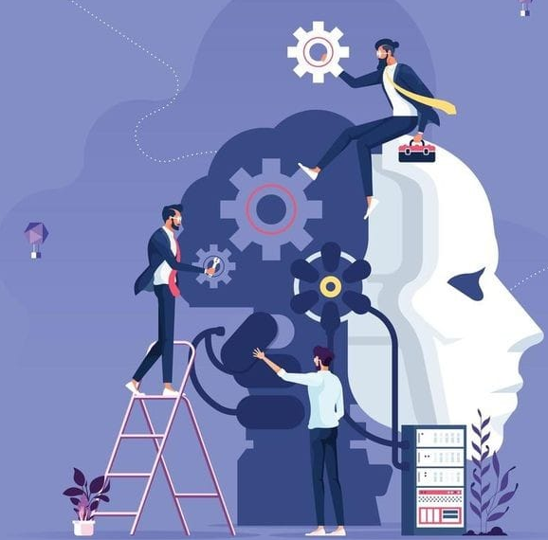
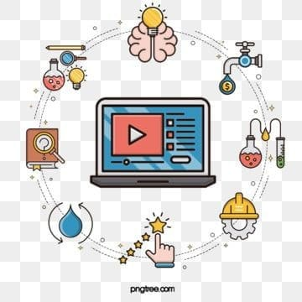
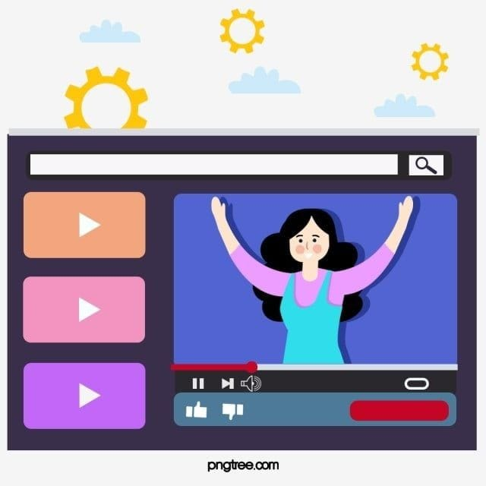
Future Scope
ML
PREDICTIONS
MORE INTERACTIVE AND DYNAMIC WEB PAGES .
More interactive & dynamic web pages
COMPUTER VISION
FOR RIGHT POSTURES
Workout Trainer

Slide 25
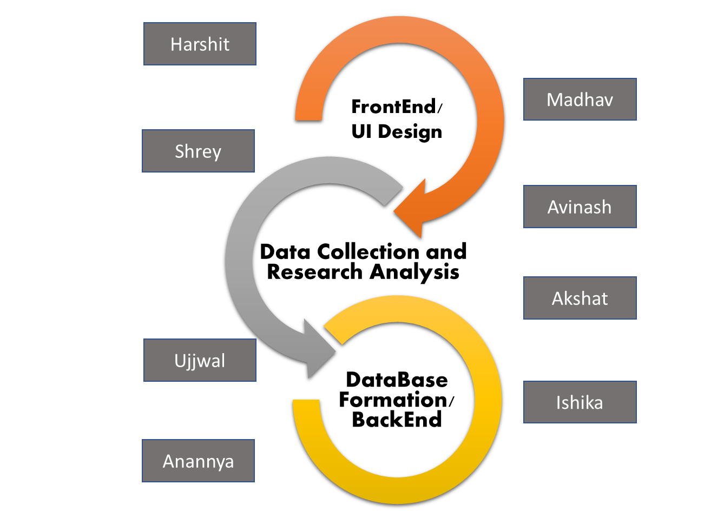
Individual contribution

Slide 26
References
1
5
Yoga Journal website for forming database
www.ncbi.nlm.nih.gov
2
https://forms.gle/SoW4jcrrEDqVX81s7
3
https://www.andiappanyoga.com/yoga-therapy-various-diseases/
4
JINJA2 and Flask Documentations

Slide 27
Thank You

Slide 28
Project Timeline
Checking Validity of solutions
Finding Causes of Problem
Finding Existing Soln. and its Limitations
Identification of Problem
Developing the project
Proposing Solutions
Implementation in Real life
R&D of new solutions
Finalizing the Project

